Slide 1
Mullaperiyar Dam: A Potential Catastrophe
By:
Tino Abraham Reji
102117066

Slide 2
Introduction
The Mullaperiyar Dam is a masonry gravity dam built on the Periyar River. It was constructed in 1895 and is one of the oldest functioning dams in India. The dam’s primary purpose is to provide water for irrigation, drinking, and hydroelectric power to Tamil Nadu.
The dam is situated in the Idukki district of Kerala, near the border with Tamil Nadu. Although it is located in Kerala, the water from the dam primarily benefits the state of Tamil Nadu.
Over the years, the Mullaperiyar Dam has faced significant safety concerns due to its age, structural integrity, and seismic activity. The potential risk of dam failure has led to ongoing disputes between Kerala and Tamil Nadu, with fears of a catastrophic disaster affecting millions of people living downstream.

Slide 3
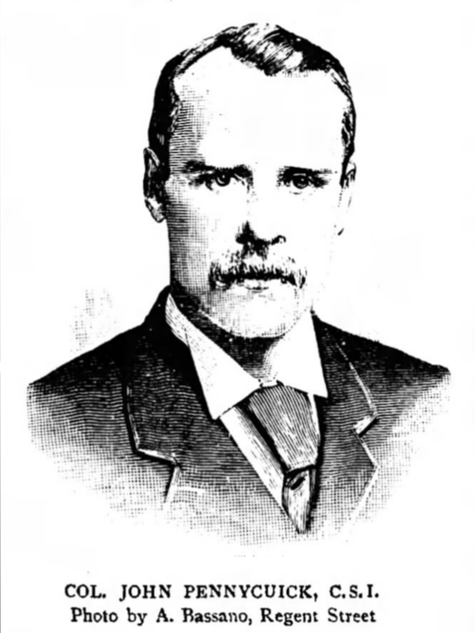
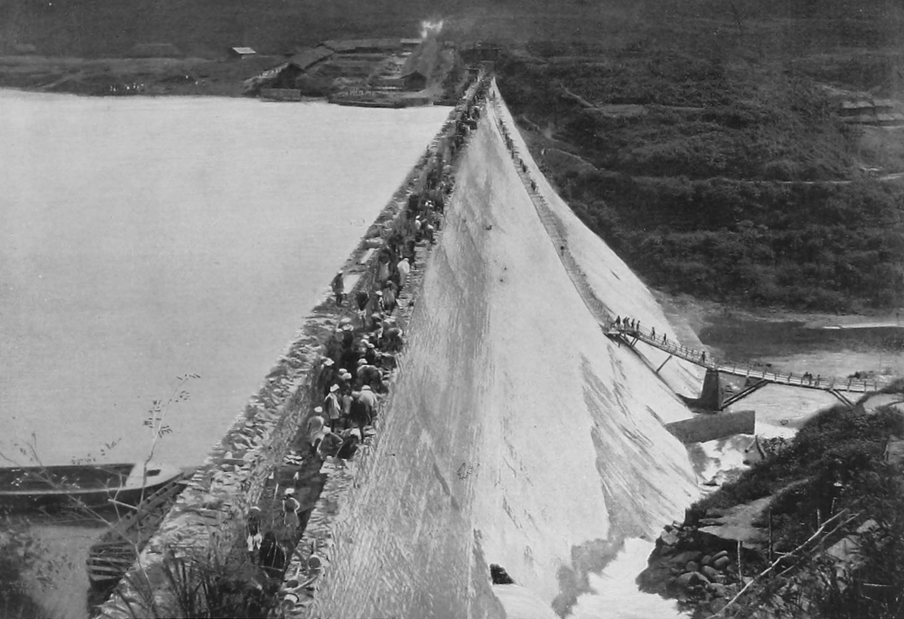
History
Mid-19th Century
(1840s to 1860s)
IN 1887
Construction of the Mullaperiyar Dam began in 1887 under the guidance of British engineer Colonel John Pennycuick. The dam was built using a mix of rubble masonry and lime surkhi mortar, a technique common during that period.
The idea of diverting water from the Periyar River to the arid regions of Tamil Nadu was conceived in the mid-19th century. The project aimed to provide a reliable water source for irrigation and support agricultural activities in drought-prone areas.

Slide 4
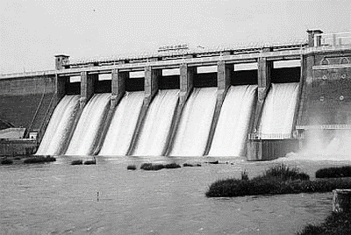
Mid-19th Century
(1840s to 1860s)
IN 1895
IN 1887
Construction of the Mullaperiyar Dam began in 1887 under the guidance of British engineer Colonel John Pennycuick. The dam was built using a mix of rubble masonry and lime surkhi mortar, a technique common during that period.
The construction faced numerous challenges, including difficult terrain, heavy monsoons, and financial constraints. Despite these obstacles, the dam was successfully completed in 1895.
The idea of diverting water from the Periyar River to the arid regions of Tamil Nadu was conceived in the mid-19th century. The project aimed to provide a reliable water source for irrigation and support agricultural activities in drought-prone areas.

Slide 5
IN 1895
IN 1887
Construction of the Mullaperiyar Dam began in 1887 under the guidance of British engineer Colonel John Pennycuick. The dam was built using a mix of rubble masonry and lime surkhi mortar, a technique common during that period.
The construction faced numerous challenges, including difficult terrain, heavy monsoons, and financial constraints. Despite these obstacles, the dam was successfully completed in 1895.

Slide 6
Importance and Benefits
Crucial for Agriculture: The Mullaperiyar Dam provides essential irrigation to over 2.1 lakh acres in Tamil Nadu, supporting thousands of farmers in districts like Theni, Madurai, Sivaganga, and Ramanathapuram.
Vital Drinking Water Source: The dam supplies drinking water to many towns and villages in Tamil Nadu, ensuring a reliable water source, especially during dry periods.
Renewable Energy Generation: It contributes to hydroelectric power production, supplying clean energy and supporting the electricity needs of Tamil Nadu.
Economic Impact: The dam boosts regional economic growth by enabling year-round agriculture, supporting local industries, and sustaining markets.
Strategic and Historical Significance: Represents an example of interstate resource sharing between Kerala and Tamil Nadu, and stands as a historic engineering achievement.

Slide 7
Controversies and Legal Battles
Water Sharing Disputes: The 1886 agreement between Kerala and Tamil Nadu regarding water allocation is seen as outdated, leading to conflicts as Tamil Nadu's water demands have increased, causing friction with Kerala over equitable distribution.
Legal Proceedings: Multiple legal battles have taken place, including Supreme Court rulings aimed at balancing safety and water sharing. These rulings have addressed some issues but have not fully resolved the disputes between the states.
Political Tensions: The issue has become highly politicized, with leaders from both states using it to garner support. Public protests and political manoeuvring have intensified the conflict and complicated efforts to find a resolution.

Slide 8
Mullaperiyar Dam: A Potential Catastrophe
Aging Infrastructure:
Seismic Risk:
Over 125 Years Old: The dam, completed in 1895, is one of the oldest still in operation, with concerns about its structural integrity.
Outdated Construction Materials: Built with rubble masonry, a method now considered outdated and potentially inadequate for modern standards.
Located in a Seismic Zone: The dam sits in a region prone to earthquakes, posing a significant risk of structural failure.
Potential for Catastrophic Failure: Even moderate seismic activity could cause the dam to crack or breach, leading to widespread flooding.
High Population Density Downstream:
Environmental Consequences:
Millions at Risk: A dam failure would endanger millions of lives downstream in Kerala and Tamil Nadu.
Massive Flooding: Uncontrolled water release would devastate towns, villages, and agricultural areas.
Destruction of Ecosystems: A catastrophic failure could annihilate local ecosystems, wildlife habitats, and farmland.
Long-Term Recovery: Environmental recovery could take decades, with irreversible biodiversity and natural resources losses.

Slide 9
WHAT IF?

Slide 10
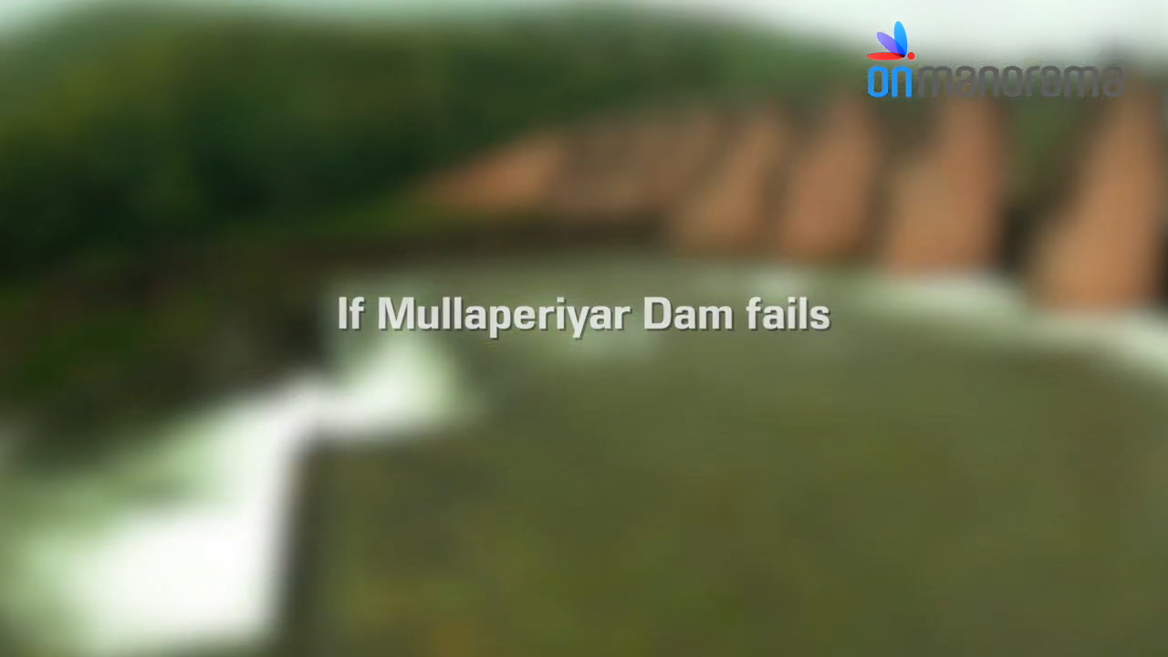
WHAT IF ?

Slide 11
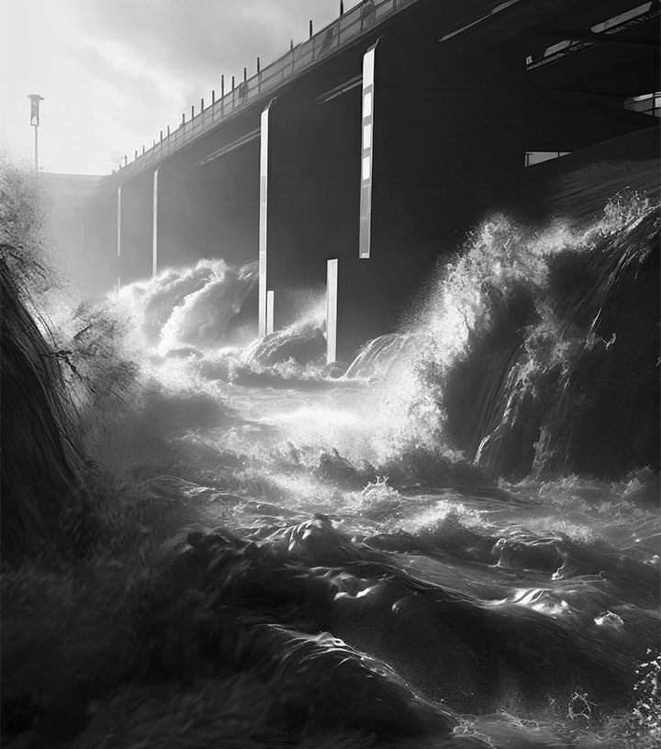
10,00,000+
Estimated Death Toll in Kerala and Tamil Nadu

Slide 12
Government Actions and Long-Term Solutions
Strengthening the Dam Structure:
Water Level Management:
Reinforcement and Modernization: To enhance the dam's structural integrity, propose reinforcing it using modern construction materials and techniques.
Regular Safety Inspections: Implement frequent and thorough inspections to monitor the dam’s condition and address any structural weaknesses.
Reducing Maximum Water Levels: Set and strictly enforce lower maximum water levels to reduce pressure on the dam, especially during the monsoon season.
Automated Monitoring Systems: Install advanced monitoring systems to provide real-time data on water levels, weather conditions, and structural stress.
Disaster Preparedness and Response:
Government and Legal Actions:
Comprehensive Evacuation Plans: and regularly update detailed evacuation plans, including Developdrills for residents in downstream areas.
Early Warning Systems: Enhance early warning systems to provide timely alerts in case of an emergency, ensuring quick evacuation and response.
Interstate Cooperation: Encourage collaboration between the Kerala and Tamil Nadu governments to address safety concerns and reach consensus on water levels and maintenance.
New Dam Construction: Consider constructing a new, modern dam in a safer location to replace the aging Mullaperiyar Dam.

Slide 13
CONCLUSION
The Mullaperiyar Dam, with its aging infrastructure and location in a seismic zone, poses significant risks that demand urgent attention. The potential for catastrophic failure threatens millions of lives and could devastate entire ecosystems. Addressing these concerns requires immediate and coordinated action from state and central governments, along with the involvement of experts and local communities. By reinforcing the dam, implementing modern monitoring systems, enhancing disaster preparedness, and exploring long-term solutions, we can mitigate the risks and ensure the dam remains a safe and reliable resource. The time to act is now, as proactive measures are crucial to preventing disaster and securing a sustainable future for the region.

Slide 14
REFERENCES
https://en.m.wikipedia.org/wiki/Mullaperiyar_Dam
https://www.manoramaonline.com/news/latest-news/2024/09/02/cwc-orders-mullaperiyar-dam-safety-check-kerala-wins.html
https://www.thehindu.com/news/national/kerala/central-water-commission-gives-nod-for-safety-review-of-mullaperiyar-dam-says-water-resources-minister-roshy-augustine/article68597068.ece
https://timesofindia.indiatimes.com/city/chennai/kerala-moves-centre-for-new-mullaperiyar-dam/articleshow/110347555.cms
Central Water Commission, Government of India. (2020). Mullaperiyar Dam – Technical Report on Safety and Structural Integrity. Retrieved from cwc.nic.in
Chandran, V. & Menon, A. (2018). Seismic Vulnerability Assessment of Mullaperiyar Dam. Journal of Structural Engineering, 45(4), 215-230.
https://youtu.be/p0qqNpcGi3I?si=RYss9RpUOEKGlAnZ

Slide 15
THANK YOU

